Slide 1


Winning the growth race
Notes:
Thank you for the opportunity to present The Tatham Group to you. My name is Denis Nixon. I am an Executive Vice president with the Tatham Group. I have been in this position, primarily responsible for Canada, for 5 years.
I was an executive for 25 years, prior to joining Michael Tatham. Both in South Africa and in Canada I have been consciously involved in process improvement to implement strategies aimed at improving ROE. At Bank of Montreal I was SVP Continuous Improvement before being promoted to head Private banking. While I understand banking my background is more in general management with a bias towards marketing. You will find a brief Bio in your package.
Ultimately our work at Tatham is about helping you grow your bottom line through improved service and sales at lower cost. Helping you win at the growth race. We do this through a systematic, disciplined approach.

Slide 2
Road Map
Our understanding of AEGON’s needs
How we would work with AEGON
How Tatham help their clients
Examples
Cost/timing
Questions/dialogue
Notes:
This road map lays out the process we will follow to get through the presentation. Although questions/discussions are shown at the end feel free to ask questions at any time.
This presentation should take no more than 20 minutes, leaving the majority of the time for dialogue.

Slide 3
AEGON needs
Increase quality
Reduce costs through efficiency
Increase sales
Notes:
What we heard from you is that you want to improve quality of service especially to distributors and advisors, and to reduce costs and to do this systematically, fast and ongoing versus once off, and increase sales.

Slide 4
Command and Control Hierarchy
CEO
Vice President
Marketing
Vice President
Finance
Vice President
Operations
Controller
Sales
Manager
Marketing
Manager
General
Manager
IT
Manager
Account
Supervisor
Advertising
Supervisor
Payroll
Manager
Purchasing
Manager
Production
Supervisor
Manager
Administration
Notes:
99.9% of companies work within this type of structure. Strategies are developed, work is delegated, objectives agreed and everyone goes to work. Part of all work is fixing problems and overcoming obstacles to implementing their strategy.

Slide 5
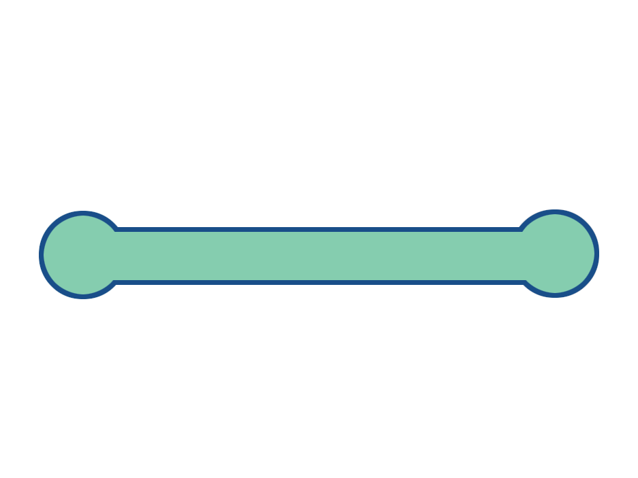
Process Centered Organization
Leadership
Process
Vision &
Strategy
Organization
Performance
Improvement
Communications
& External
Relations
Customer
Need
Development
& Market
Products
Acquire
& Set Up
Business
Service
Customer
Requirements
Manage
Claims
& Payouts
Customer
Satisfaction
Support
Process
Information
Resources
Financial
& Actuarial
Legal &
Compliance
Human
Resources
Notes:
Our view of the world is different and has been for 36 years. We help our clients to see themselves this way and also to manage accordingly.
This view of an organization helps to focus on end-to-end processes (beginning and ending with the customer).
In this view the leadership and support people work FOR the business processes.
The customer is central – the focus is on satisfying the customer.
Customer service 101 which most companies never achieve.

Slide 6
Process Centered Organization/ Command and Control Hierarchy
CEO
Leadership
Process
Vision &
Strategy
Organization
Performance
Improvement
Communications
& External
Relations
Vice President
Marketing
Vice President
Finance
Vice President
Operations
Customer
Need
Development
& Market
Products
Acquire
& Set Up
Business
Service
Customer
Requirements
Manage
Claims
& Payouts
Customer
Satisfaction
Controller
Sales
Manager
Marketing
Manager
General
Manager
IT
Manager
Support
Process
Information
Resources
Financial
& Actuarial
Legal &
Compliance
Human
Resources
Account
Supervisor
Advertising
Supervisor
Payroll
Manager
Purchasing
Manager
Production
Supervisor
Manager
Administration
Notes:
They never achieve it because it is difficult to satisfy the customer in a hierarchical structure because the business processes cut across silos and work within one-size- fits-all-policies. This causes a process/hierarchy logjam. It grows exponentially depending on the number of hands-offs or interfaces there are in a process, conflicting goals and so on.
This is not news to you!!

Slide 7

Process Centered AEGON
Vision and
Strategy
Organization
Performance
Improvement
Communications
and external
relationships
Individual Life Insurance
Segmented Funds
Mutual Funds
Mutual Fund Dealership Services
Institutional Investment management
Retail Investment Management
Financial planning – Money Concepts
Information
Services
Financial and
actuarial
Legal and
compliance
Human
Resources
Notes:
To bring this closer to home we would see AEGON more in these terms. Because the AEGON name is up there you’re probably going to be looking for what is not right…….if we work with you one of the first things we will do is work with you to get it right!! So please accept it as an example.

Slide 8
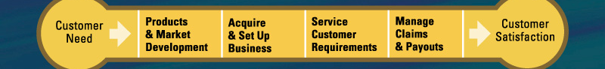
Process Centered AEGON
Vision and
Strategy
Organization
Performance
Improvement
Communications
and external
relationships
Individual Life Insurance
Information
Services
Financial and
actuarial
Legal and
compliance
Human
Resources
Notes:
If we zoom in on one process - which provides about 80% or more of your revenue it will the Individual Life Insurance process. If we were to give you a single arrow to shoot into one of the four steps where a big improvement were to make a difference where would it be?

Slide 9
Process Centered AEGON
Vision and
Strategy
Organization
Performance
Improvement
Communications
and external
relationships
Individual Life Insurance
Improve time to setup
and process new business
Information
Services
Financial and
actuarial
Legal and
compliance
Human
Resources
Notes:
I am open to correction but I understand that you have specifically highlighted at least one opportunity. Improve time to set up and process new business. It is a part of the whole process and you probably chose it because of customer feedback.
When this issue is resolved the opportunity is to look right across the process and guided by the customer to systematically improve the process to a state of quality and integrate it end-to-end. In the integration step interfaces and hand-offs become very apparent, IF they are being a constraint to speed or efficiency.
And your competition is there already. In a recent talk given publicly to a group who attended an executive BootCamp one of your competitors spoke about how they are increasing business by being able to promise 24 hour policy issuance of new individual life policies – 100% accurate.

Slide 10
And - AEGON wants to:
“Achieve these results by doing it ourselves – guided autonomy”
Notes:
We also heard that you want to be able to achieve these results by doing it yourself and not by having a hoard of consultants do it to you.
We agree with you.
Let us show you how we work with our clients.

Slide 11
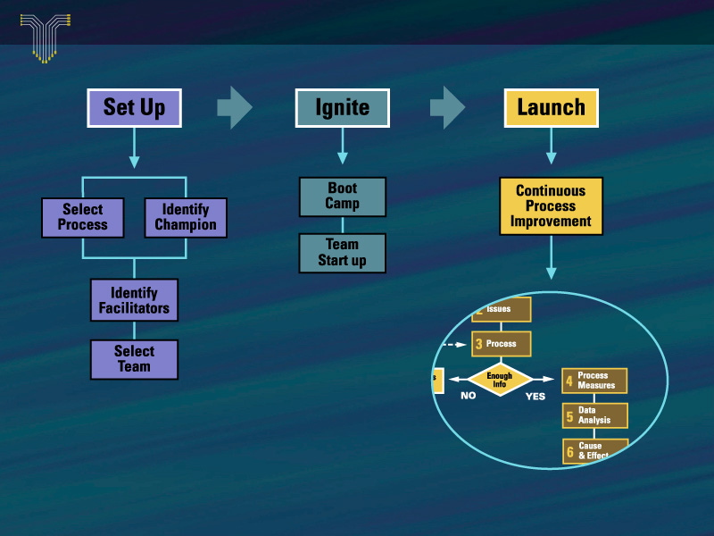

BPE Launch Process
Notes:
At a high level we have a three step process Setup, ignite and launch. Each step is important, skipping one leads to poor results.
This looks deceptively simple. Let me share some ways in which it is powerful:
We have done nothing other than develop this process for 36 years – this is all we do
It has been field tested in numerous different industries, countries and organizations from 200 people to 165,000 people
It works 100% of the time when followed to resolve any issue a company faces in satisfying customers or implementing strategies.

Slide 12
BPE Launch Process
Notes:
Let’s start with set up.
This step links your strategy directly to improvement work.
From which segments is our growth going to come from?
Which business processes service these segments?
What issues do we have with the outcomes of these processes?
At a process level:
- what are the customer issues with the outcomes of this process?
Whereabout in the process is the undesirable outcome occurring?

Slide 13
BPE Launch Process
Notes:
Ignite is about getting the team educated as to the “ how” and energised about solving the issue.

Slide 14
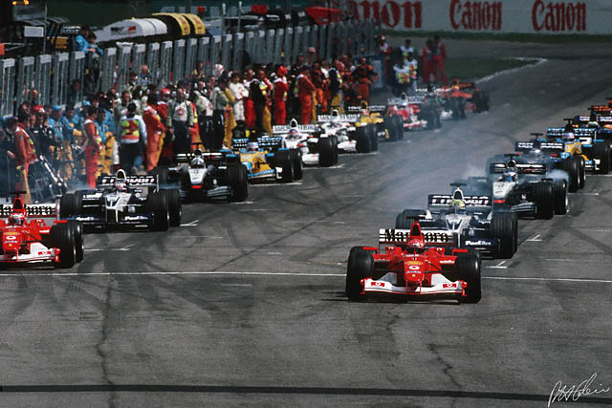
Ignite – Start your engines
Two Day BootCamp
3rd day Team startup
Notes:
Ignite has two steps
In a way it is about starting your engines! The team working on the issue will attend a BootCamp for Teams and then on day three begin the work itself. Let me tell you a little about BootCamp for it is unique and very different.

Slide 15
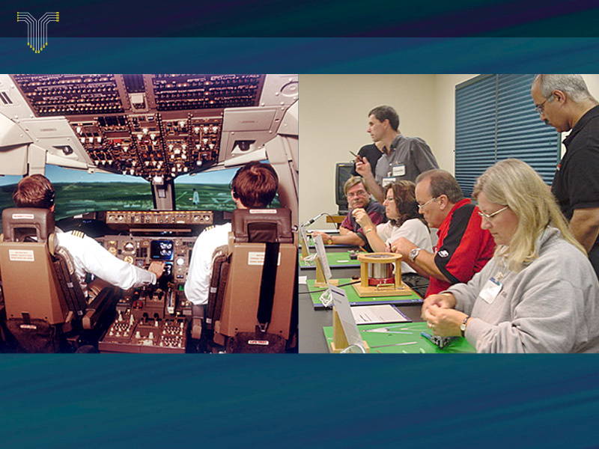
Flight Simulator / Business Simulator
Boot Camp
Notes:
A perfectly competent pilot goes to the simulator to ensure that when faced with a challenge or unusual situation she reacts with the right actions and not with an intuitive response.
Story of car.
BootCamp is like that – participants fail and then go back to the step before failure and try again until they succeed.
In BootCamp we use the field tested process to take a badly broken company through a systematic approach to first fix qualtiy once and for all, then to speed up the process, then to improve responsiveness to customer changes and finally to a point where the company,s ready for e-commerce. In doing so the bottom line grows significantly and choices for the future expand.

Slide 16
Two Executive Clients’ Comments
“I have experienced BootCamp first-hand, and I am confident that our NASA Senior management and, ultimately, the whole of NASA will benefit from BootCamp. I have seen the results at TRW and I know other companies that have achieved similar results.”
Goldin, Chief Administrator, NASA
“Participating in BootCamp was the most valuable learning experience of my business career.”
Ken Lewis, Chairman and CEO, Bank of America

Slide 17
BPE Launch Process

Slide 18
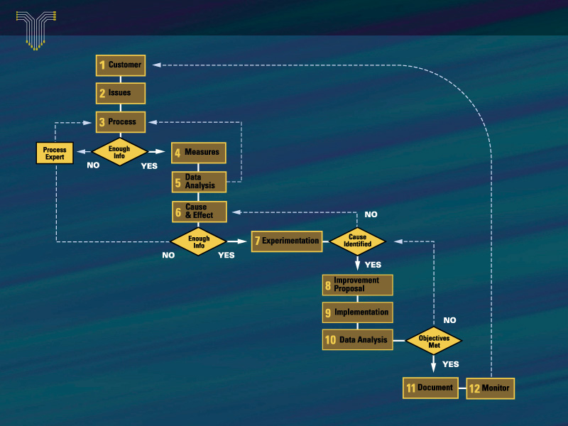
Launch
Notes:
Launch: This is the core process that all our client teams, throughout the world use to resolve the business issues that were selected in the setup step. AT this level the steps look like many that you might have seen before. However there are some key unique differences.
It is customer focused in a disciplined, data driven way
The process is studied end-to-end to avoid the hierarchical effect
It relies on scientifically disciplined experimentation to prove that the root cause of the issue has been found before implementing anything
It is carried out by people in the process and finally
It is designed to make implementation simple and gains stick. Results are measured and further improved as possible.

Slide 19
FAST!
Usually within six weeks – resolved at root level
and implemented
Notes:
And it works fast.
Let me give you an example of our client’s work – for they did it – using our field tested approach. The Bank of America had a problem in many ways similar to what you are facing. Their core business was not growing fast enough (7%). And that was not going to support an increasing ROE. They had grown through acquisition but did not see further opportunity for that beyond the NationsBank, Bank of America merger.

Slide 20

1996 - The Initial Challenge
Grow annual pre-tax net income by an incremental
$1Billion
by the end of 1999
*Information pertains to Consumer and Commercial Banking at former NationsBank
Notes:
So Ken Lewis set this goal.
We were recommended to them and they brought us into their business. Goals always beg the question HOW? We helped them get clear on what their strategy was and we showed them how to systematically redesign their processes to implement their strategy.

Slide 21
“Our old focus was on what we thought customers wanted. We were looking from the inside out (“push”). Our new focus is from the outside in (“pull”)-- we start from the customer's point of view and let the customers tell us what they want.
Ken Lewis, President
Bank of America
From “push” to “pull”
“We want to be the people who make banking work for you in ways it never has before.”
Notes:
Their strategy seems very close to yours – let’s provide the customer (distributor, advisor) with the quality service they want.
Hard selling is what we term push.
You’re the best, a joy to deal with, trusted, reliable, make me feel good and are responsive to my needs – please let me work with you = pull.

Slide 22
1997 - Linking Strategy with Action
Actions
1. Picked two customer groups that represented half of the total growth opportunity
2. Named Customer Group Champions with authority of the President’s office to provide the voice of the customer and hack through internal complexity
3. Chartered cross-organizational teams to build enterprise-wide plans for each target customer groups
4. Launched 20~ initiatives to build or improve processes critical to executing on strategy
Notes:
They used customer segmentation to focus their work – wealth management and small and medium sized business. About 60% of their growth was to come from these two sectors.
Ands soon got to solving any issues those customers said they had with the bank. Here’s one example

Slide 23
Customer: “Why is it so complicated for you to change my CD when I want to add money or change my rate? Then you send me a notice that’s incorrect and tell me to call someone who can’t help me.”

Slide 24
A close-up look at EZCD
From To
Steps
Cycle Time
Customer Experience
Associate Experience
18
9 days
Limited, conflicting communication/ information
Confusion, frustration
Distrust, blaming, frustration
Helplessness, heroics, fatigue
3
10 Minutes
Clear, complete communication/ information
Easy, simple, fast
Success, trust, teamwork
Easy, simple, fast
Notes:
This is one simple result they got. It was significant because although they solved the problem for their wealth clients the solution could be used right across the bank. And it boosted customer retention and consolidation.

Slide 25
What About The Billion Dollar Target?
+12%
+11%
+13%
105%
98%
100%
Net Income Planned
(avg. annual growth = 12%)
% of Net Income Achieved/Planned
1996 1997 1998 1999
We are right where we planned to be!
*Current franchise prorated to approximate the size of the 1996 NationsBank franchise, based on number of households and businesses.
Notes:
These are the results – significant increase in organic before tax net profit growth – achieved in a huge organization in three years.
That’s what you will get from applying our know how in your company.

Slide 26
A Few Clients
Northrop-Grummon – B2 Bomber
NASA – Hubble telescope
Policy Management Systems – Respond to customers fast
Hartford Insurance – Take costs out of group insurance setup and maintenance
Canada Life – Quality service at low cost globally
Bank of America – Put $1bn dollars on bottom line
Notes:
Using our methods – Northrup-Gammon (TRW) was able to get a prototype of the B2 bomber completed on time and won the contract from the Dept of Defense.
NASA used our methods to not only double the productivity of their telescope but also to integrate their processes and dramatically reduce the time from request to data. Time available for data collection by telescope grew from 2400 hrs p.a. to 5300 hrs p.a. Time from request to data dropped from 18 months to 3 months. At the same time they were able to reduce operating expenses by $35 million p.a.
Policy management Systems – who design software for the insurance industry, dramatically improved their service levels.Systems enquiries dropped from a response time of 4 months to 5 days and problem resolution from a mean of 3 months to 13 days.
Bank of America needed to add $1 billion to their bottom line from their traditional businesses.
.

Slide 27

The Tatham Group
36 yrs – one focus
End-to-end customer focused process design and redesign
Bottom line results
100% customer satisfaction
Canadian based H.O.
Notes:
The Tatham Group has done just one thing for 36 years in Canada and 22 years in USA – help organizations systematically integrate their processes across the organization to get better bottom line results. Most of our clients have been in the USA, only in recent years has interest in holistic process management taken hold Canada.
We have a record of 100% customer satisfaction although we have and continue to improve the way that we do things.

Slide 28
What makes us different?
We license one time for life
Our clients always get great results
Payback is usually in less than one year
We coach clients to self sufficiency
We support clients ongoing, forever, as needed
BootCamp is an incredible tool
Our approach links the client’s strategy to systematic improvement work
Our clients work on end-to-end processes
Re-engineering and automation only when necessary
Notes:
One time for life means just that
Because clients are working on implementing their strategies the results always give what they are looking for
We charge a lot but then you wouldn’t mind paying an exorbitant amount if the payback was less than a year and results were carried forward year after year.
Our contract says that you are self sufficient when you say so. In fact we never leave you – as improvements are found as new issues are faced we are always there, no charge beyond the licence fee to assist, advise help.
Ken Lewis who attended BootCamp three times, once as a participant and twice as an observer said..and I quote: ‘ Bootcamp is the single most …etc.”
David you attended BootCamp – what did you think?
This work is about implementing your strategies – not some theoretical model of management
The business process cutting across the hierarchy are where the opportunities lie – for that is your business.
In our years we have seen very little need for re-engineering but when needed out methods will expose the need and make it easy to do
Automation or systems solutions have often been the driver of change. In our work they are the caboose (even though we don’t have cabooses in Canada anymore)

Slide 29
What makes us different?
We have 100% customer satisfaction
The methods work 100% time when followed
We constantly improve our processes and pass all improvements onto our clients
Improving operational performance through process redesign is our only business – and has been for 36 years

Slide 30
We are resultants
not consultants
Notes:
No off the shelf solutions to your business issues
No hordes of people consuming your and your people’s time
We transfer knowledge in a planned, disciplined, way while you are achieving results. J.I.Time knowledge transfer.
One time payment. The clock does not tick each time that we speak to you.
You tell us when we can go..or come….we do not push ourselves onto you.
We are thus free to be true partners.

Slide 31

Questions/Discussion
Thank you!

Slide 32
Journey
Let’s find out what this is about!
Senior Management
Participate
in BootCamp

Slide 33
Journey
Senior Management
Participate
in BootCamp
Let’s see how it works in practice!
Two teams resolve
two customer issues
using methods learned

Slide 34
Journey
Senior Management
Participate
in BootCamp
Two teams resolve
two customer issues
using methods learned
Let’s manage the organization this way in the future
Organization licensed

Slide 35
Journey
Senior Management
Participate
in BootCamp
Two teams resolve
two customer issues
using methods learned
Let’s align and focus the work to strategy
Organization licensed
Senior Management
work to determine
strategic links and
support structure

Slide 36
Journey
Senior Management
Participate
in BootCamp
Two teams resolve
two customer issues
using methods learned
Organization licensed
Senior Management
work to determine
strategic links and
support structure
IMPLEMENT

Slide 37
Journey
Costs
Senior Management
Participate
in BootCamp
Two teams resolve
two customer issues
using methods learned
USD 50,000
Organization licensed
USD 425,000
Senior Management
work to determine
strategic links and
support structure
USD 750,000
plus
USD 400 per
employee
IMPLEMENT
NIL

Slide 38
Journey
Costs
Senior Management
participate in Executive
BootCamp
Two teams resolve
two customer issues
using methods learned
USD 50,000
Organization licensed –
one-time, life-time
USD 425,000
- 3 Process Master schools – included
- extra Schools USD 5,000 each.
- One set BootCamp equipment included.
- extra BootCamp sets USD 125,000 each. - - Workbooks, consumables, replacements for BootCamp USD 70 per participant.
Senior Management
Workshop to determine
strategic links and
support structure
USD 750,000
plus
USD 400 per
employee
IMPLEMENT
NIL

